Slide 1

Flood monitoring
Name:JAYASURIYA
Reg no:422621106018

Slide 2
Innovation of project
In this technology project you will continue building your project by developing the platform as per
project requirement. Use web development technologies wherever needed. After performing the
relevant activities create a document around it and share the same for assessment.

Slide 3
Introduction of project
let's dive into flood monitoring! Flood monitoring is the process of collecting and analyzing data to assess and predict flood conditions. It involves monitoring various factors such as rainfall, river levels, and soil moisture to understand the potential for flooding. This data is collected through sensors and gauges placed in strategic locations. By continuously monitoring these parameters, authorities can issue timely warnings and take necessary actions to mitigate the impact of floods. Flood monitoring plays a crucial role in ensuring the safety of communities and minimizing damage caused by flooding. Let me know if you have any specific questions or if there's anything else I can assist you with.

Slide 4
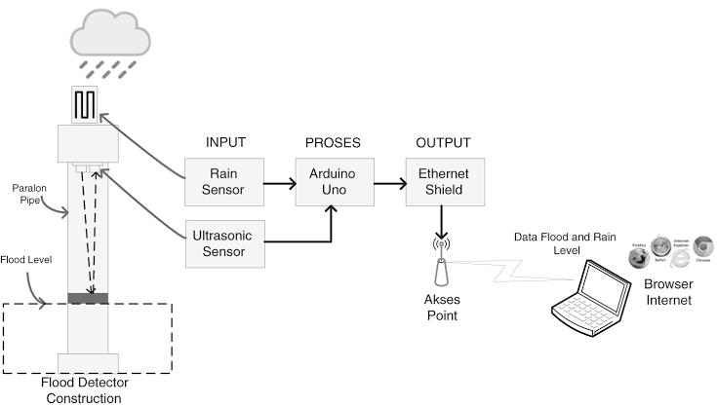
Flood monitoring diagram

Slide 5
Program
#include <stdio.h>
#include <stdlib.h>
#include <stdbool.h>
bool readFloodData() {
return false;
}
int main() {
bool isFlooding = readFloodData();
if (isFlooding) {

Slide 6
....
printf("Flood detected! Take immediate action.\n");
} else {
printf("No flood detected. All clear.\n");
} return 0;
}

Slide 7
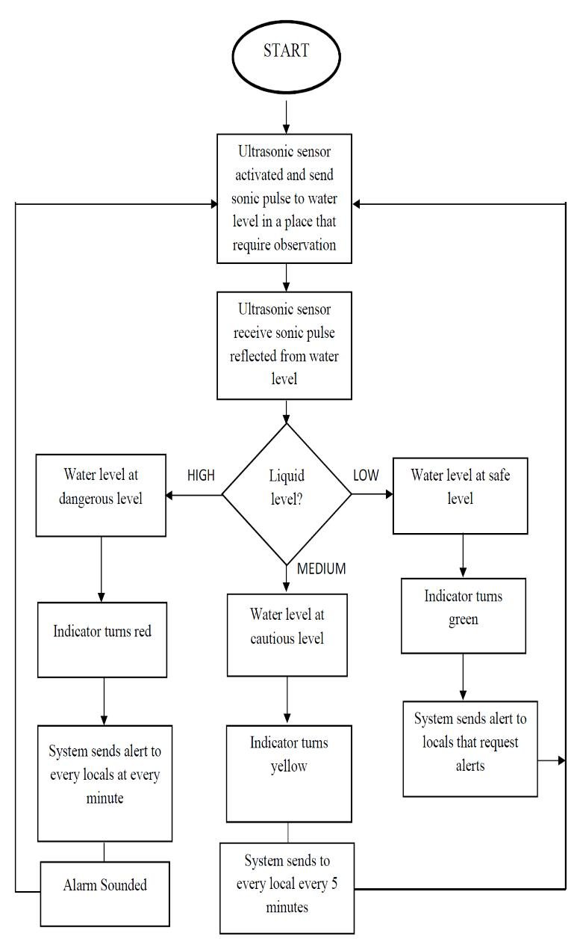
Flow chart

Slide 8
Related work
I can help you with flood monitoring-related work! Flood monitoring involves collecting data on factors such as rainfall, river levels, and soil moisture to assess flood conditions. This data is crucial for understanding flood risks and taking appropriate measures to mitigate the impact. It may involve setting up sensors, analyzing data, and issuing timely warnings to communities at risk. Let me know if you have any specific questions or if there's anything else I can assist you with.

Slide 9
Conclusion
In conclusion, flood monitoring is a critical process that involves collecting and analyzing data on factors like rainfall, river levels, and soil moisture to assess flood conditions. By monitoring these parameters, authorities can issue timely warnings and take necessary actions to mitigate the impact of floods. It plays a crucial role in ensuring the safety of communities and minimizing damage caused by flooding. If you have any more questions or need further information.

Slide 10

....

